Slide 1
Organization and planning of scientific research Lecture #3 Attracting graduate students in science: scientific and educational projects
Zholaman Bektemessov

Slide 2
Plan
Attracting graduate students in science: scientific and educational projects
Competitive research funding
Requirements for writing a thesis

Slide 3
A science project
is an educational activity for students involving experiments or construction of models in one of the science disciplines.
Students may present their science project at a science fair, so they may also call it a science fair project.
Science projects are done by students worldwide.
Science projects may be classified into four main types.
Notes:
There is a science contest in university, which held every march, the contest of science project for middleschool students named after Dzholdasbekov.

Slide 4
Classification of Science projects (1)
Experimental projects, also known as investigatory projects, start with a question (AKA a hypothesis), use the scientific method to complete the research, and end with a report detailing the results and conclusions and an abstract.
Engineering projects, also known as technology projects, start with a design of a machine or mechanical structure with the purpose of improving strength or performance. Researchers implement all their design ideas in a model they construct. The model will be tested to evaluate the design.
Notes:
Experimental project (исследовательский проект): Исследование влияния различных уровней pH на скорость прорастания семян пшеницы. – Гипотеза: более кислые или щелочные условия негативно влияют на прорастание. – Метод: выращивание семян в растворах с разным уровнем pH, измерение скорости прорастания. – Результаты: анализ данных, графики, выводы.
Engineering project (инженерный проект): Разработка и тестирование улучшенной конструкции лопастей для ветряных турбин. – Задача: создать более эффективные лопасти для генерации энергии при слабом ветре. – Метод: проектирование и 3D-моделирование, изготовление прототипов, испытания в аэродинамической трубе. – Результаты: сравнительный анализ КПД разных моделей.

Slide 5
Classification of Science projects (2)
Display projects involve a creative assembly of a display board and construction of a model to show a visual representation of a larger fact. Making a model of the solar system, a house, or of a simple electric circuit are considered display projects. Display boards are used to enhance the presentation.
Theoretical projects may involve the same format as experimental or engineering projects. However, for several possible reasons, such as lack of feasibility due to costs, the actual experiment is not performed.
Notes:
Display project (демонстрационный проект): Создание интерактивной модели тектонических плит Земли. – Цель: показать, как движения литосферных плит приводят к землетрясениям и образованию гор. – Реализация: макет Земли с подвижными пластинами, которые можно двигать вручную или с помощью механического привода. – Презентация: стенд с инфографикой о тектонических процессах.
Theoretical project (теоретический проект): Математическое моделирование распространения эпидемий. – Цель: изучить влияние различных факторов (вакцинация, карантин, скорость передачи вируса) на распространение инфекции. – Метод: разработка системы дифференциальных уравнений (например, SIR-модели), анализ результатов с помощью симуляций. – Особенность: из-за сложности реального эксперимента проект остается теоретическим

Slide 6
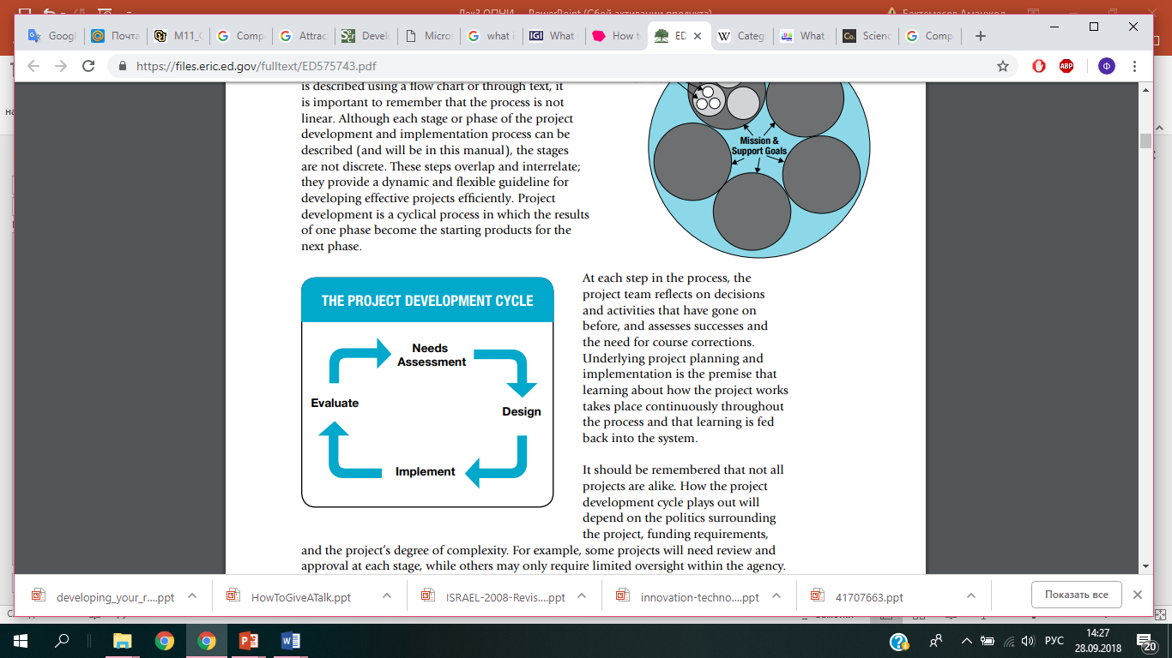

Slide 7
What Is a Science Fair Project?
A science fair project is an investigation that is designed to solve a problem or answer a question. It is a 'science' fair project because you use a procedure called the scientific method to answer the question.
The 'fair' part takes place when everyone who has done a project gathers together to showcase their work. Usually a student takes a poster to a science fair to explain the project. For some science fairs the actual project accompanies the poster. Projects and presentations are evaluated and grades or awards may be given.

Slide 8
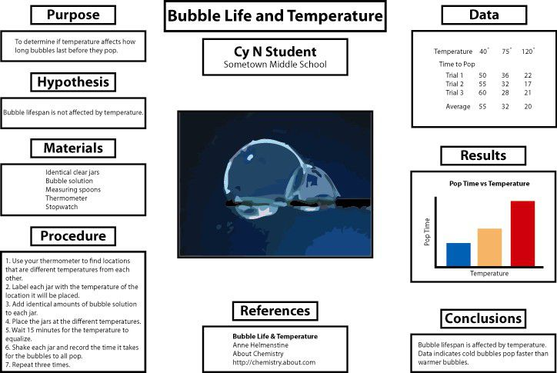
How to Organize Your Science Fair Poster

Slide 9
What is Educational Project
A project in education is a collaborative process, frequently involving different teacher and educational staff, that is carefully planned to achieve a particular aim of learning.
Notes:
Проект "Виртуальная лаборатория по физике"
Цель: Разработка интерактивного цифрового инструмента для изучения физических экспериментов без необходимости реального оборудования.
Участники: Учителя физики, специалисты по образовательным технологиям, программисты.
Реализация:
Разработка симуляций механических, оптических и электрических экспериментов.
Включение тестовых заданий и объяснений в программу.
Пилотное внедрение в школе или университете.
Ожидаемый результат: Улучшение понимания сложных физических явлений у студентов за счет визуализации и интерактивности

Slide 10

Developing Your research plan/Program
As a juggler on the tenure track circuit, you've got to decide which balls to toss in the air first.
Stephanie G. Adams, Ph.D.

Slide 11
Before the Plan
Solidify your research interests.
Ascertain that there is a need - talk to colleagues and review the literature.
Generate Ideas.
Assess future needs.
Assess your skills.
Determine what it do you want to accomplish.
Formulate your question.

Slide 12
The Plan
Where do you want to be in 10, 5, 3 or 1
Outline a yearly growth plan.
Write action oriented goal statements.
Establish timelines for actions/activities.
Write action steps for tenure/promotion process.

Slide 13
Developing Your Research Program

Slide 14
Developing Your Research Program
pick questions carefully

Slide 15
Developing Your Research Program
pick questions carefully
make them very interesting
to you
to the field
to the community
to funding sources

Slide 16
Developing Your Research Program
pick questions carefully
make them very interesting
have more than one project

Slide 17
Developing Your Research Program
pick questions carefully
make them very interesting
have more than one project
be realistic
availability of funds
for promotion
for grant renewal

Slide 18
Developing Your Research Program
pick questions carefully
get money
take an entrepreneurial approach to your research program.

Slide 19
Developing Your Research Program
pick questions carefully
get money
take an entrepreneurial approach to your research program.
determine your needs
Equipment and supplies
Staff

Slide 20
Developing Your Research Program
pick questions carefully
get money
determine your needs
start small if necessary
institutional grants
federal agencies
private foundations
companies

Slide 21
Developing Your Research Program
pick questions carefully
get money
determine your needs
start small if necessary
don’t stop until have more than you need

Slide 22
Developing Your Research Program
pick questions carefully
get money
get help
Colleagues
Students
Staff
Develop an Infrastructure

Slide 23
Developing Your Research Program
pick questions carefully
get money
get help
work very hard

Slide 24
Developing Your Research Program
pick questions carefully
get money
get help
work very hard
report your findings
to establish credibility, publish not in niche journals but top journals.
presentations

Slide 25
Developing Your Research Program
pick questions carefully
get money
get help
work very hard
report your findings
document your accomplishments
Don’t be afraid to “Toot Your Own Horn”
awards

Slide 26
Connect with Senior Faculty
Build a network of people who know you and your work.
Approach at conferences
Do it over time as part of a “way of life”
You won’t even notice it happening but after a few years you will have a web of contacts at all levels and all over Kazakhstan, Europe, US and elsewhere
Talk to other faculty members to establish potential for collaborative research.

Slide 27
Final Tips
Limit classroom preparation to a maximum of two hours per hour of lecture.
Spend 30-60 minutes A DAY on scholarly writing.
Spend at least 2 hours a week on discussions with colleagues focused on teaching and research.

Slide 28
Final Tips
Keep daily records of work time expenditure. Recording helps new faculty self-monitor how well they are meeting Commitments 1–3.
Integrate research interests into lectures.
Doing so leads to greater enthusiasm for teaching as well as recruitment of students as research assistants.
Enjoy what you do, otherwise don’t do it!!!!!

Slide 29

Research Design – Tips for Data Collection Procedures

Slide 30
In piecing together a research design, data collection procedure is one important consideration.
Data collection procedures answer the who, when, and how of research proposal or research project.

Slide 31
Four Steps to Data Collection Research Design
According to literature, four steps related to the data collection process include
(a) the determination of the purpose of the research;
(b) the format e.g. quantitative survey or qualitative interviews;
(c) the sample - i.e. who should be included in the study, and the sample size – i.e. how many should be included; and
(d) whether the survey should be cross-sectional – i.e. the data collected at one point in time, or longitudinal, wherein data is collected over time as in quantitative studies.
Notes:
Исследование: Влияние экранного времени на академическую успеваемость студентов
Определение цели исследования
Цель: Изучить, как количество времени, проводимого перед экраном (смартфон, компьютер, планшет), влияет на академическую успеваемость студентов.
Формат исследования
Метод: Количественный (анкетирование) + качественный (глубинные интервью).
Анкетирование поможет собрать статистические данные, а интервью – глубже понять влияние экранного времени.
Выбор выборки и размера выборки
Кто включен: Студенты университетов (бакалавриат).
Размер выборки: 300 студентов из разных факультетов.
Тип исследования (cross-sectional или longitudinal)
Cross-sectional: Один раз провести анкетирование и интервью.
Longitudinal (если есть возможность): Отслеживать изменения в экранном времени и успеваемости студентов на протяжении 1-2 семестров.

Slide 32
Quantitative Qualitative
A quantitative research design uses a survey questionnaire to poll participants about a certain subject. A qualitative study involves careful observation and or interviews of members of the group under study. Unless the study uses a pre-test post-test design, most quantitative studies are taken at one place and time whereas qualitative studies seem to take place over an extended period of time. It is difficult to gain a sense of a particular society or phenomena through observation at one place and time.

Slide 33
Cross-sectional or Longitudinal
When collecting data in a quantitative study, the researcher must determine if he will collect pass out and collect the data surveys at one place and time or over an extended period of time. A data collected at one place and time is called cross-sectional whereas data collected over an extended period of time is labeled longitudinal.

Slide 34
More Guidelines for Quantitative Studies
Another consideration for data collection in quantitative study is distribution method. This point refers to how the researcher will distribute and collect the survey questionnaires.
One method is personal distribution by which the researcher hands or sends a copy of the survey directly to the target participants.
A second technique is to place the survey online through SurveyMonkey or some other service and allow people to randomly access the questionnaire according to convenience and interest level.

Slide 35
More General Guidelines for Qualitative Studies
It is also pointed out that in qualitative studies other data collection procedures would include
(a) purposefully selecting participants and sites for interviews and observations;
(b) how best to record qualitative observations i.e. take field notes;
(c) how to conduct interviews i.e. how many interviewees at one time, what kind of questions to ask them;
(d) what if any documents should be collected and how best to analyze them; and
(e) whether to audio and visual material.
Notes:
Исследование: Трудности студентов в освоении высшей математики
Целенаправленный выбор участников и мест для интервью и наблюдений
Участники: Студенты 1–2 курса, изучающие математический анализ и линейную алгебру.
Место: Университетские аудитории, библиотеки, онлайн-платформы для обучения.
Как лучше записывать наблюдения
Полевые заметки во время занятий: какие темы вызывают наибольшие трудности, какие методы преподавания эффективны.
Наблюдение за групповыми обсуждениями студентов (например, в учебных чатах или на семинарах).
Как проводить интервью
Формат: Индивидуальные интервью с преподавателями и студентами.
Вопросы:
«Какие темы в курсе высшей математики кажутся вам наиболее сложными?»
«Какие методы обучения помогают вам лучше понимать материал?»
Количество: 10–15 студентов и 5 преподавателей.
Какие документы собирать и как анализировать
Анализ экзаменационных работ и домашних заданий (какие ошибки совершаются чаще всего).
Изучение методических материалов и учебников: какие способы объяснения сложных тем используются.
Использование аудио- и визуальных материалов
Запись интервью (с разрешения) для дальнейшего анализа.
Видеофиксация занятий для изучения взаимодействия преподавателя и студентов.

Slide 36
How to Deal with Collected Data
Another consideration when setting up a research design is how one will analyze the data after collecting it.

Slide 37
References
https://files.eric.ed.gov/fulltext/ED575743.pdf
Creswell, J. W. (2009). Research Design. Thousand Oaks, CA : Sage Publications, Inc.
Kerlinger, F. N., & Lee, H. B. (2000). Foundations of Behavioral Research, 4e. Belmont, CA : Cengage Learning

Slide 38
Thank you for attentions!

